Slide 1
Sail 缺陷分析与修复

Slide 2
Sail 缺陷分析与修复
Sail 是一种用于定义处理器指令集架构 (ISA) 语义的语言，已经应用在了 riscv，CHERIoT 等 ISA 上
但是在应用过程中发现了不少缺陷或者不足
lexer, rewriter bug
编译器
语法支持不足
缺陷分类
工具
功能未实现
下游反馈
Notes:
缺陷来源三种 - 编译器在编译流程出现的各类问题，lexer，各类优化器，语法重写 - 细分为三类 - 编译器bug: lexer 解析 bug - 语法支持: bitfield 需要增加语法糖 - 功能为实现: 部分静态分析未实现 - 工具，例如，格式化，lint，sailcov - 下游，例如 sail_riscv 中的浮点数支持逐步正在获得 sail 原生支持 本次将对 编译器和工具相关的一些案例进行分析

Slide 3
编译流程及缺陷触发位置
Sail
TypeCheck
Lexer(ocamllex ott)
Rewrite
sailcov
Yacc(menhir)
Jib
other...
Ast
Fmt
C
Notes:
1. 下面的框图是 Sail 整体编译流程，其中深色标记的为本次分享要介绍的有缺陷的部分 2. 以 c_backend 为例 (sail 能生成 c 语言，SystemVerilog, Latex, html 等) - 左上角为 Sail 源代码 - 右下角为 C 代码 3. 一共有 5 个深色图，对应共 4 个缺陷（后两个图） - Lexer，TypeCheck -> 编译器缺陷 - Fmt -> 工具缺陷 - sailcov -> 编译器 rewrite 和 sailcov 共同导致的缺陷 依次介绍：现象 -> 原因 -> 解决方案

Slide 4
1. Lexer (Unit)
let foo = (
)
<lit> ::= true
| false
| ()
| NUMBER
| undefined
| bitzero
| bitone
| BINARY_LITERAL
| HEXADECIMAL_LITERAL
| STRING_LITERAL
图1. example code
$ ./sail ./demo.sail
Syntax error:
./demo.sail:2.0-0:
2 |) |^
| current token: )
图2. error msg
图3. menhir

Slide 5
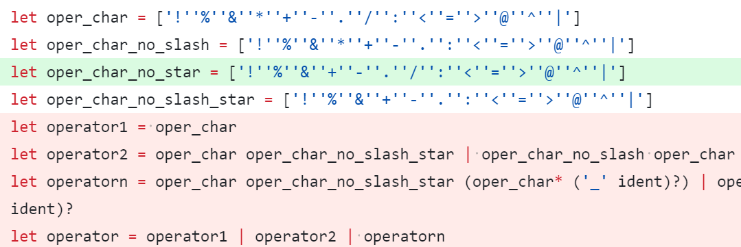
1. Lexer (Operator)
let foo =/**/ 1
- 运算符规则:
- 字符序列 !%&*+-./:<>=@^|#
- 后跟可选的 _identify
- 示例: <=_unsigned, </>
图1. example code
$ ./sail ./demo.sail
Syntax error:
./demo.sail:1.8-8:
1 |let foo =/**/ 1 | ^
| current token: =/**/
图2. error msg
图3. source code

Slide 6
2. Fmt (Example)
function a () -> int = {
1// aaa
// bbb
}
// ccc
function b () -> int = {
let a = {
1
// ddd
};
1
}
let c = 1
// eee
function a () -> int = {
1 // aaa
}
// bbb
// ccc
function b () -> int = {
let a = {
1
};
// ddd
1
}
let c = 1
图2. formatted code
图1. origin code

Slide 7
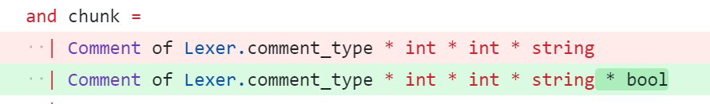
2. Fmt (comments,defs) -> chunks -> doc
let comments = ref [] in
let defs = Parser.file (Lexer.token comments) lexbuf
close_in in_chan;
(!comments, defs)
let chunk_defs source comments defs =
let comments = Stack.of_seq (List.to_seq comments) in
let chunks = Queue.create () in
(* 1. pop header comments *)
chunk_header_comments comments chunks defs;
(* 2. pop comments *)
let _ = List.fold_left (fun last_span def ->
chunk_def source last_span comments chunks def
) (None, Some 0) defs in
(* 3. pop remaining comments *)
Stack.iter
(fun c ->
match c with
| Lexer.Comment (comment_type, comment_s, e, contents) ->
Queue.add (
Comment (
comment_type, 0,
comment_s.pos_cnum - comment_s.pos_bol,
contents, false
)
) chunks
)
comments;
chunks
图1. source to (comments, defs)
function a () -> int = {
1 // aaa
// bbb
}
if xxx // comment
then xxx // comment
else xxx // comment
图3. handle tralling comments
图3. fixed

Slide 8
3. TypeCheck (Example)
struct bool2 = {
field: bool,
}
mapping m : bool <-> bool2 = {
true <-> struct { field = false },
false <-> struct { field = true }
}
let foo = m(true)
- 1. add `$[complete]` addribute
#[complete]
mapping m : foo <-> bar = {
...
}
- 2. add `$[allow(incomplete)]` for let exp
#[non_exhaustive]
enum MyEnum {
Variant1,
Variant2,
// may have more in the future
}
- 3. reuse match complete check on mapping's both sides
图1. example sail code
$ ./sail --just-check ./demo.sail
Error:
./demo.sail:10.4-7:
10 |let foo = m(true) | ^-^
| Top-level let statement must not have any side effects. Found side effects: incomplete pattern match
图2. error msg
图3. fix ways

Slide 9
3. TypeCheck: (Annotation)
- 1. add `$[complete]` addribute
#[complete]
mapping m : foo <-> bar = {
...
}
- 2. add `$[allow(incomplete)]` for let exp
图1. 修复方法
| DEF_aux (DEF_mapdef _, def_annot) ->
- effects := EffectSet.add IncompleteMatch !effects;
+ if Option.is_some (get_def_attribute "complete" def_annot) then
+ effects := EffectSet.add IncompleteMatch !effects;
图2. 修复代码

Slide 10
3. TypeCheck (Scatter)
val encdec : bool <-> bool2
scattered mapping encdec
// file1.sail
mapping clause encdec = true <-> struct { field = false }
// file2.sail
mapping clause encdec = false <-> struct { field = true }
end encdec // end is optional
Ast
TypeCheck
Rewrite
图1. example code
Jib
ast = typecheck ast
let ast = Scattered.descatter ast in
+ typecheck again...
图2. fix

Slide 11
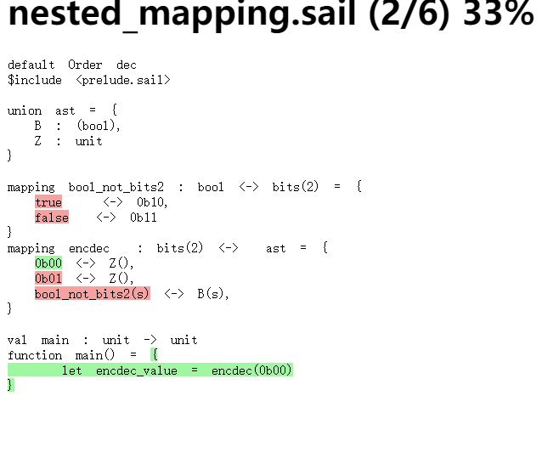
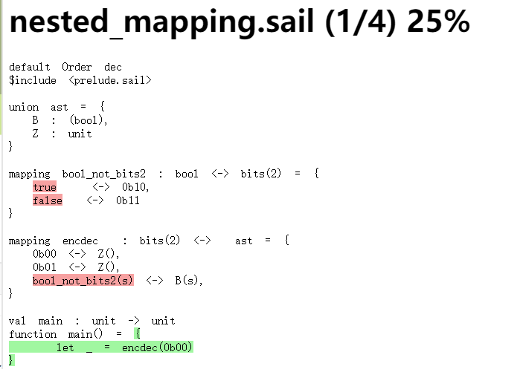
4. sailcov: (Example)
图1. right
图2. wrong

Slide 12
4. sailcov
sail
libsail_coverage.a
图1. how does sailcov run
-c_include sail_coverage.h
-c_coverage
C
Model(binary)
demo.branches
demo.taken
sailcov
图2. .branches 格式
B 5, "nested_mapping_demo.sail", 16, 2, 16, 6
T 5, 11, "nested_mapping_demo.sail", 16, 2, 16, 6
F 3, "main", "nested_mapping_demo.sail", 20, 18, 22, 1
coverage.html

Slide 13
4. sailcov (After Rewrite)
function encdec_forwards_matches arg# = let head_exp# = arg# in $[complete] $[mapping_match] match match head_exp# { b__0 if $[overloaded { "name" = "==", "is_infix" = true }] eq_bits(b__0, [bitzero, bitzero]) => Some(true), b__1 if eq_bits(b__1, [bitzero, bitone]) => Some(true), (mapping0# : bitvector(2))
if bool_not_bits2_backwards_matches(mapping0#)
=> match bool_not_bits2_backwards(mapping0#) { s => Some(true), _ => None()}, _ => None() } { Some(result) => result,
None(_) => $[incomplete] match head_exp# {_ => false}
}
图1. where loc lost?

Slide 14
总结
本次分享了几个 sail 相关的缺陷分析及修复的 4 个案例
分析了 sail 的 Lexer，AST，TypeCheck，Rewrite 等多个模块
分析了 sailfmt，sailcov 两个工具
可以供各位老师参考

Slide 15
感谢指导

